Slide 1
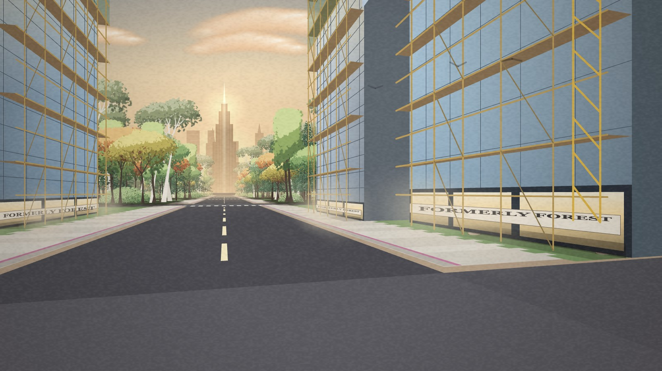
A2C · REFLECTION · 1 OF 2
The bugs were between the code and the body
WHAT HAPPENED
One swing across the middle of the picture became two half-swings.
A big rewrite changed many settings at once, and it felt worse.
I rolled back with git and kept only two small fixes.
FOR MY PRACTICE
Test with a real camera and real people, early.
Change one thing at a time.
Commit small working steps, so I can always go back.
Chopping kept failing. The hand tracking was fine: my own rules were wrong.
Notes:
My reflection has two key insights, and what they taught me about my practice.
Insight 1: interaction bugs live between the algorithm and a real body. Chopping kept failing, and the problem was not the model, it was my rules. I assigned hands by which half of the picture they were in, so one swing across the middle became two half-swings. Then I over-corrected with a big rewrite that changed many thresholds at once, and it felt worse. I rolled back with version control and re-applied only two small fixes.
For my practice: I will test with a real camera and real people early, change one thing at a time, and commit small working steps so I can always go back. Even this week, testing with my own hands led me to change the gestures, let walking and building happen together, and teach the sketch which hand is which.

Slide 2
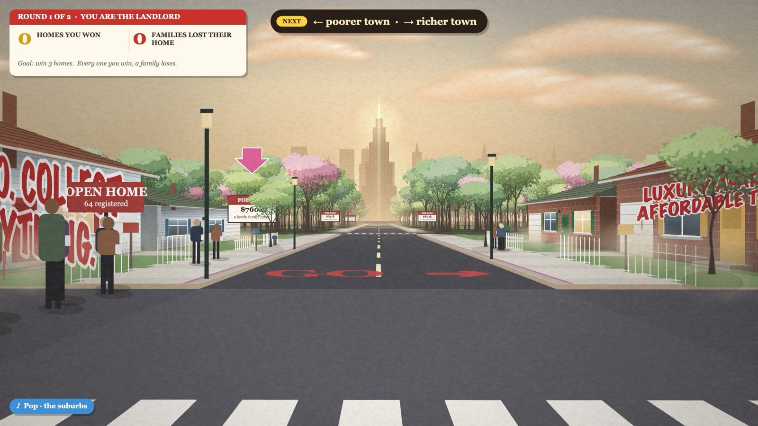
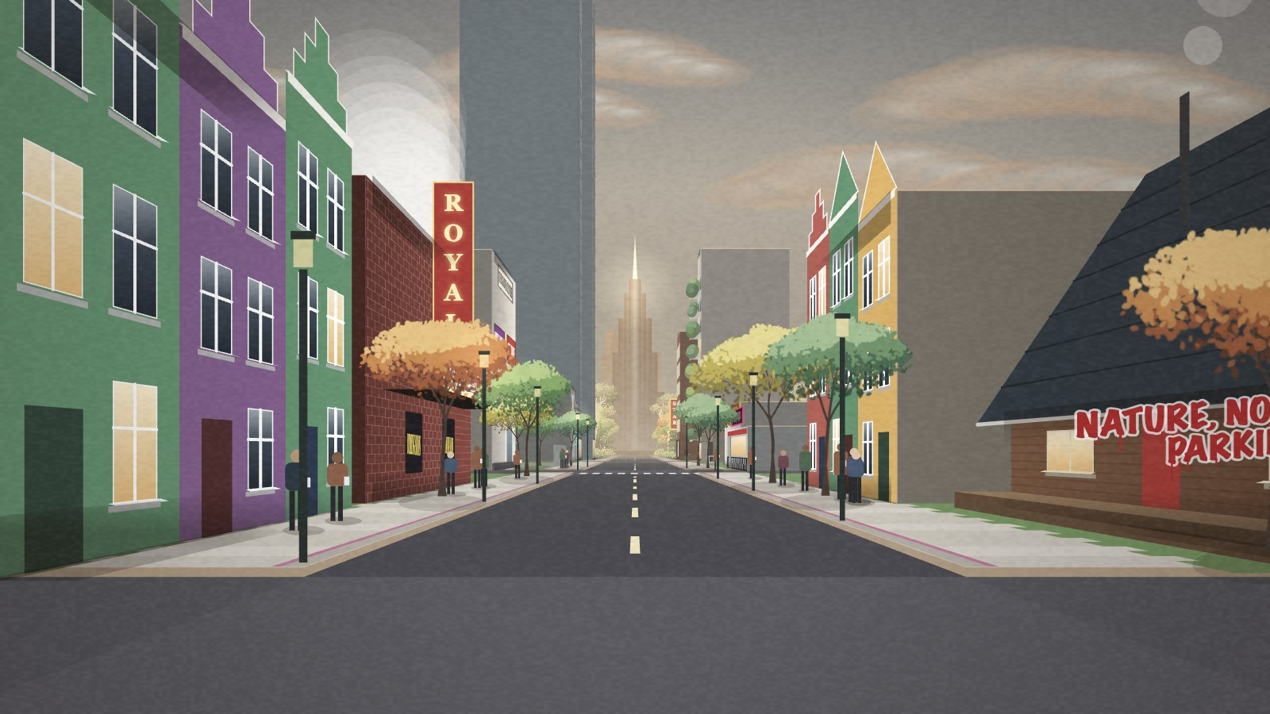
A2C · REFLECTION · 2 OF 2
Let the world answer, not the words
WHAT HAPPENED
FOR MY PRACTICE
Feedback on my Monopoly street: the meaning was unclear.
I changed it to forest to city and took most of the text away.
A change you cause yourself says more than a sign.
Old code was still running: removing it made every frame twice as fast.
Build the core interaction first and check people understand it.
Write down what the player should feel, and judge every feature by it.
Remove old code as soon as the direction changes.
BEFORE: SIGNS AND SCORES
The cost of building is felt, not read. Simplify the message, test with real bodies, and let version control make bold changes safe.
NOW: THE WORLD ANSWERS
Notes:
Insight 2: let the world answer instead of explaining with words. My first version was a Monopoly street full of signs and scores, and the feedback was that the meaning was unclear. I pivoted to forest-to-city and removed most of the text. The piece became calmer and clearer, because a consequence you cause yourself is more persuasive than a slogan. The pivot also showed that old Monopoly code was still running; removing it and caching colours made every frame twice as fast.
For my practice: I will prototype the core interaction first and check that people understand it before adding detail; write down what the player should feel and judge every feature against it; and remove old code as soon as the direction changes.
Closing: overall, the work reaches its main aim: the cost of building is felt rather than read. The biggest lessons were about process: simplify the message until the interaction carries it, test with real bodies early, and use version control as a safety net that makes bold decisions possible.

